Slide 1
8th grade Parent presentation for the 2022-2023 school year Bel Air High School Counselors

Slide 2
School counselors
Mr. Naus
A-F
Edward.Naus@hcps.org
Ms. Hackett
G-Mi
Lori.Hackett
@hcps.org
Ms. Knight
Mo-P
BIO Med
Terry.Knight
@hcps.org
Ms. McKinney
Q-Z
Brittany.Mckinney
@hcps.org
Contact your counselor if you have questions!

Slide 3
What’s the difference????
High School
Vs
Middle School

Slide 4
KEY TERMS
Credit- unit of measure used to count the number of classes that you have passed in your high school career. 26 = Graduation
Semester – Half of the school year, = two quarters of report cards.
Elective- a class that you may choose to take as an option to fill a requirement or based on your interest.
Requirement- a class the state of Maryland or Harford County says you must take in order to graduate.
Prerequisite- a class successfully completed before you may register for a higher level class

Slide 5
The Schedule
You will have the opportunity to earn 8 Credits Each Year
You will have 4 classes per day
Classes are about 85 minutes long
Most classes are all year (except health and PE 9)

Slide 6
 | A Day | B Day
1 | American Government | Drama
2 | Spanish 1 | Algebra 1
3 | Honors English 9 | Biology
4 | PE 9 / Health | Foundations of Tech
Sample Schedule

Slide 7
 | A Day | B Day
1 | English 9 | Journalism
2 | Health / PE 9 | American Government
3 | Intro Alg / Alg 1 | Intro Alg / Alg 1
4 | Fine Art Prep | Biology
Sample Schedule Daily Math

Slide 8
 | A Day | B Day
1 | Honors Alg 2 | Spanish 1
2 | AP American Gov't | Prin Biom Sci
3 | Hnr Biology GS | Honors English 9
4 | Guitar | PE 9 / Health
Sample Schedule BioMed

Slide 9
Graduation Requirements
Courses | Credits Required | Grade 9 | Grade 10 | Grade 11 | Grade 12
English | 4 | English 1 | English 2 | English 3 | English 4
Math | 4 | ✓ | ✓ | ✓ | ✓
Science | 3 | Biology | IPC or Chem | ✓
Social Studies | 3 | Government | World History | U. S. History
PE | 1 | ½ | Another ½ Credit any year
Health | 1 | ½ | 1/2
FOT/AP Comp Sci | 1 |  | ✓
Fine Art | 1 | ✓
Career Pathway | 4-6 | ✓ | ✓ | ✓ | ✓
TOTAL | 26

Slide 10
Graduation Requirements
Service Learning- 75 Hours Total (25 hours each year at HCPS)
Testing Requirements: SEPG

Slide 11
Eligibility Requirements
Starting with the first quarter next year you must pass all of your classes every quarter to remain eligible
NO E’s allowed
Behavioral reports can make you ineligible (suspension)

Slide 12
Student Education Planning Guide

Slide 13
2022– 2023 Freshmen Registration Form

Slide 15
Make sure to include 8 credits and
2 Alternates (A1,A2)- be thoughtful about this!
Consult with teachers and parents when selecting classes
Consider rigor of whole schedule (work and college classes included)

Slide 16
Course Registration App Directions:
1. Go to https://www.hcps.org/students/courserequests
2. Sign into the app using your username and password you would use for your school login.
3. Fill in your courses EXACTLY how you have them on your course registration sheet. (Hint- if you do "Ctrl-F", you can type in the course numbers to easily find your classes.
Double check that you have 8 classes
AND 2 Alternates!
Make sure to put in your pathway AND click "finish course requests" to submit your courses.

Slide 17
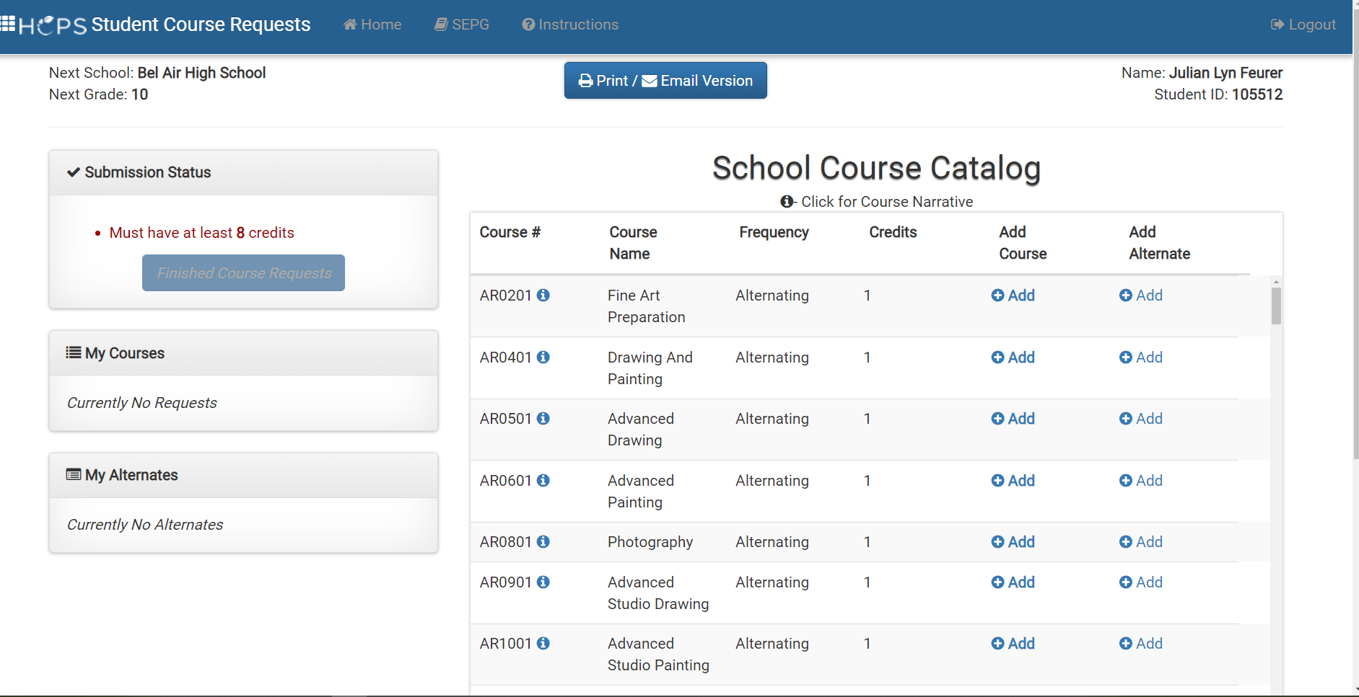

Slide 18
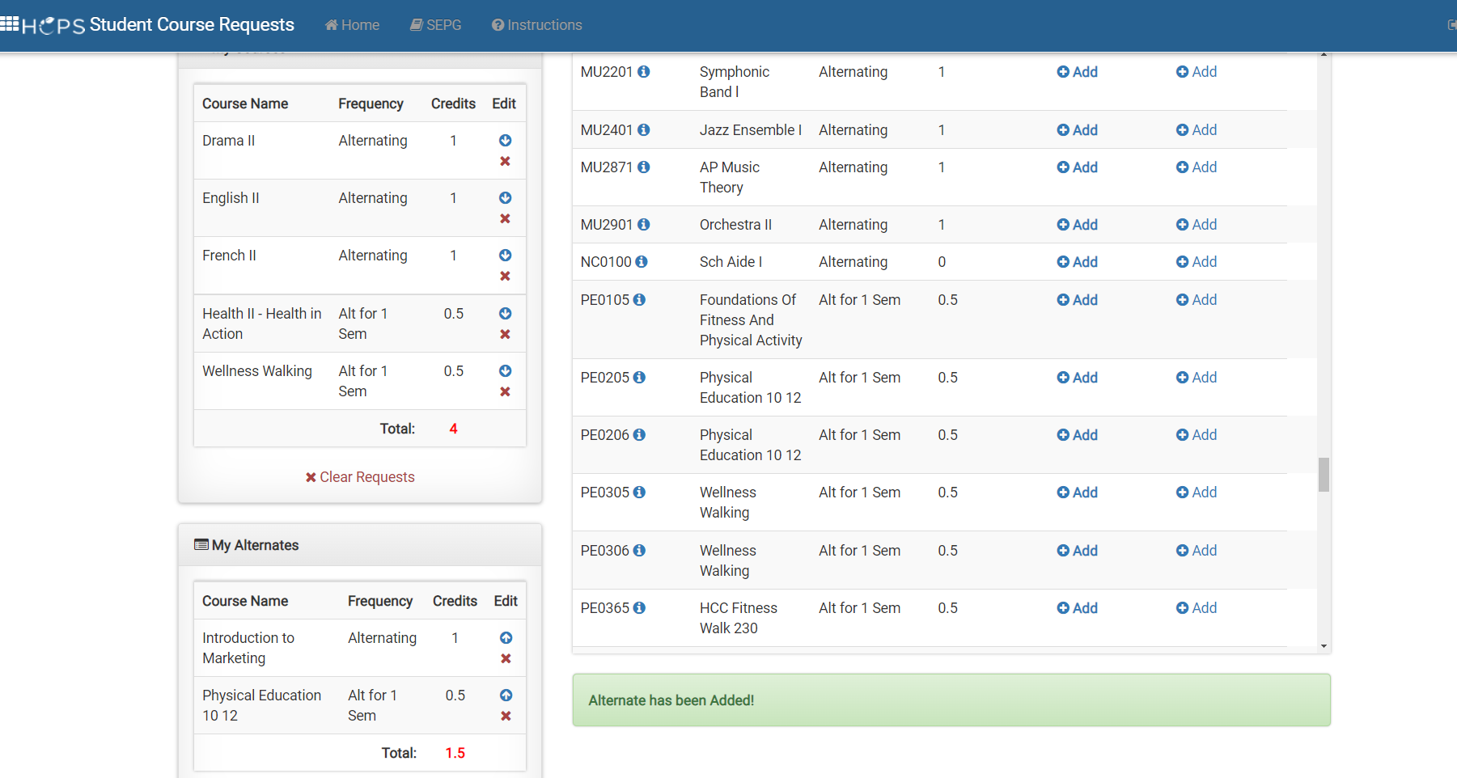

Slide 19
Steps for Course Selection
Have conversations with your teachers and parents.
Fill out your course selection sheet.
Go into the app and put your classes in.
Return your form to your teacher for submission

Slide 20
Itslearning- check out your students’ Itslearning counseling tile in the "Resources" tab
HCPS.ORG - Student Education Planning Guide
Bel Air High School Website
Helpful Websites

Slide 21
School counselors
Mr. Naus
A-F
Edward.Naus@hcps.org
Ms. Hackett
G-Mi
Lori.Hackett
@hcps.org
Ms. Knight
Mo-P
BIO Med
Terry.Knight
@hcps.org
Ms. McKinney
Q-Z
Brittany.Mckinney
@hcps.org
Contact your counselor if you have questions.

Slide 22
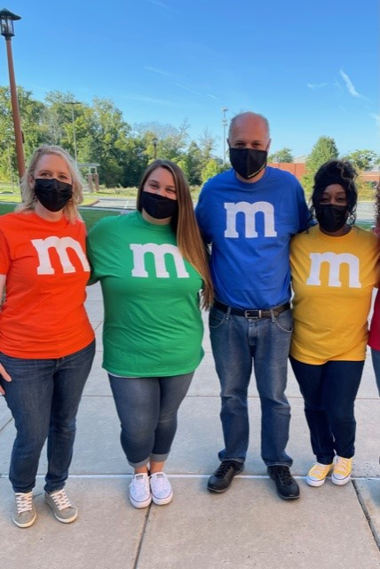
We look forward to having you and your student join the Bobcat Family!

